Slide 1

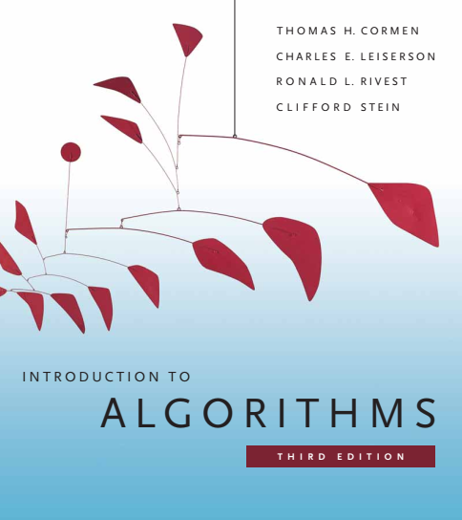
Design and Analysis of Algorithms
Dr. Sajid Iqbal
sajidiqbal.pk@gmail.com
Reference Book
Introduction to Algorithms 3rd Edition By Thomas H. Cormen et. al.
https://mitpress.mit.edu/books/introduction-algorithms-third-edition
COMEDXD

Slide 2
The Priority Queue
An Application of heap Data Structure

Slide 3
Background
Heapsort is an excellent algorithm and has many uses.
Priority queue is one of the most popular applications of a heap
As with heaps, priority queues come in two forms: max-priority queues and min-priority queues.
We will focus here on how to implement max-priority queues, which are in turn based on maxheaps
You can use similar procedure to write min-priority queues.
Array Idx
Priority
Data Elm.
1 | 2 | 3 | 4 | 5
5 | 7 | 8 | 10 | 12
DE1 | DE2 | DE3 | DE4 | DE5

Slide 4

Max Priority Queue Operations
It is a data structure for maintaining a set S of elements with associated values called $keys$.
A $max_priority queue$supports the following operations:
INSERT(S, x): inserts the element x into the set $S$, which is equivalent to the operation S = S ⋃ {x}.
$MAXIMUM(S)$: returns the element of $S$ with the largest key.
$EXTRACT_MAX(S):$removes and returns the element of $S$ with the largest key.
$INCREASE_KEY(S, x, k):$increases the value of element $x$’s key to the new value $k$, which is assumed to be at least as large as $x$’s current key value.

Slide 5

Min Priority Queue Operations
A $min_priority queue$supports the following operations:
INSERT(S, x): inserts the element x into the set $S$, which is equivalent to the operation S = S ⋃ {x}.
$Minimum(S)$: returns the element of $S$ with the largest key.
$Extract_Min(S):$removes and returns the element of $S$ with the largest key.
$Decrease_Key(S, x, k):$increases the value of element $x$’s key to the new value $k$, which is assumed to be at least as large as $x$’s current key value.

Slide 6

Uses of Priority Queues
One of use of max-priority queues is to schedule jobs on a shared computer
The max-priority queue keeps track of the jobs to be performed and their relative priorities.
When a job is finished or interrupted, the scheduler selects the highest-priority job from pending jobs by calling $EXTRACT_MAX$
The scheduler can add a new job to the queue at any time by calling $INSERT$
One of use of min-priority queue is in an event-driven simulator
The items in the queue are events to be simulated, each with an associated time of occurrence that serves as its key.
The events must be simulated in order of their time of occurrence
The simulation program calls $EXTRACT_MIN$at each step to choose the next event to simulate.
As new events are produced, the simulator inserts them into the min-priority queue by calling $INSERT$

Slide 7
Use of Heap in Priority Queue
In a given application elements of a priority queue correspond to objects in the application
We often need to determine which application object corresponds to a given priority-queue element, and vice versa.
A handle (address, pointer or anything else) of the object is required to be kept in each heap element as data item
The exact makeup of the handle depends on the application
We also need to link the handle in application using array index
Application
[1,5,7]
1 | 2 | 3 | 4 | 5 | 6 | 7 | 8 | 9 | 10
O1 | O2 | O3 | O4 | O5 | O6 | O7 | O8 | O9 | O10

Slide 8
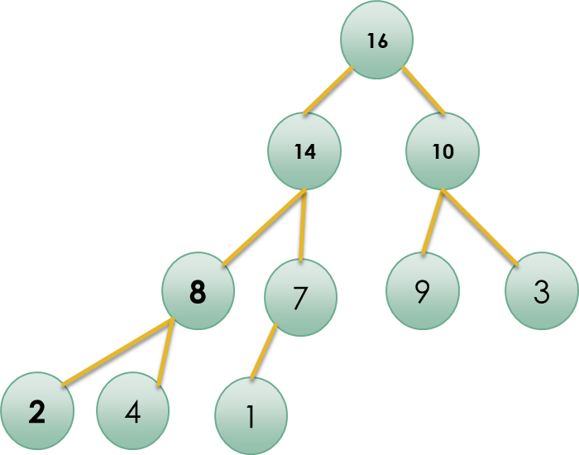

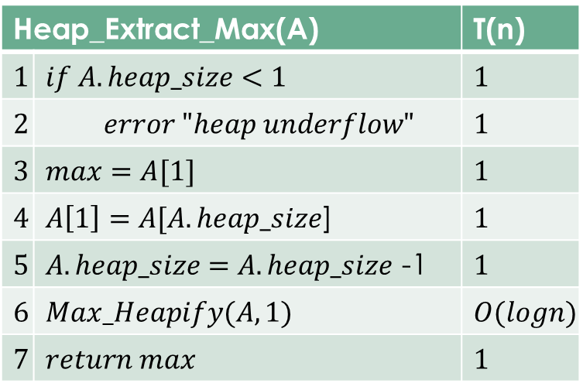
Priority Queue Operations
Time Complexities of basic operations
Heap_Maximum = $θ(1)$
Heap_Extract_Max(A) = $logn+5→O(logn)$
Heap_Maximum(A) |  | T(n)
1 | Return A[1] | 1
Heap_Extract_Max(A) |  | T(n)
$$1$$ | $$if A.heap_size<1$$ | $$1$$
$$2$$ | $$error "heap underflow"$$ | $$1$$
$$3$$ | $$max=A[1]$$ | $$1$$
$$4$$ | $A\left[1\right]=A[A.heap_size$] | $$1$$
$$5$$ | $A.heap_size$ $=A.heap_size$ -1 | $$1$$
$$6$$ | $$Max_Heapify(A,1)$$ | $$O(logn)$$
$$7$$ | $$return max$$ | $$1$$

Slide 9
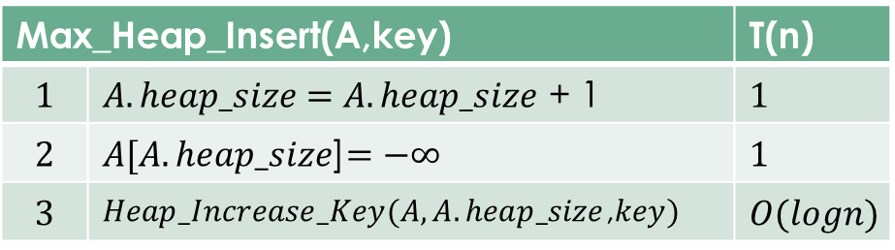
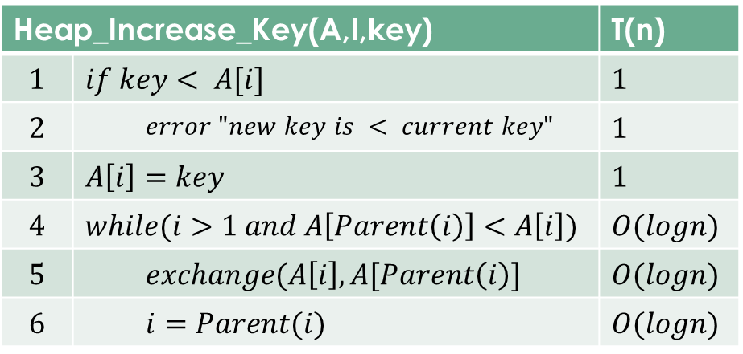

Priority Queue Operations
Time Complexities of basic operations
Heap_Increase_Key = $O(logn)$
Max_Heap_Insert = $O(logn)$
A heap can support any operation in $O(logn)$ time
Heap_Increase_Key(A,I,key) |  | T(n)
$$1$$ | $$if key< A[i]$$ | $$1$$
$$2$$ | $$error "new key is < current key"$$ | $$1$$
$$3$$ | $$A\left[i\right]=key$$ | $$1$$
$$4$$ | $$while(i>1 and A\left[Parent\left(i\right)\right]<A\left[i\right])$$ | $$O(logn)$$
$$5$$ | $$exchange(A\left[i\right],A[Parent\left(i\right)]$$ | $$O(logn)$$
$$6$$ | $$i=Parent(i)$$ | $$O(logn)$$
Max_Heap_Insert(A,key) |  | T(n)
$$1$$ | $A.heap_size$ $=A.heap_size$ + 1 | $$1$$
$$2$$ | $A[A.heap_size$]$=−∞$ | $$1$$
$$3$$ | $Heap_Increase_Key(A,A.heap_size$,$key)$ | $$O(logn)$$

Slide 10

Thanks for watching
Dr. Sajid Iqbal
Assistant Professor
Department of Computer Science
Bahauddin Zakariya University, Multan
sajidiqbal.pk@gmail.com
YouTube Channel: COMEDXD
Allah Hafiz

